Slide 1
Molecular Biology Biol 480
Lecture 13 February 15th, 2019

Slide 2
Announcements/Assignments

Slide 3
Where were we…
Continuous/discontinuous DNA replication
Completing the lagging strand
Activities of DNA polymerases—(multi-protein subunit complexes)
Telomeres

Slide 4
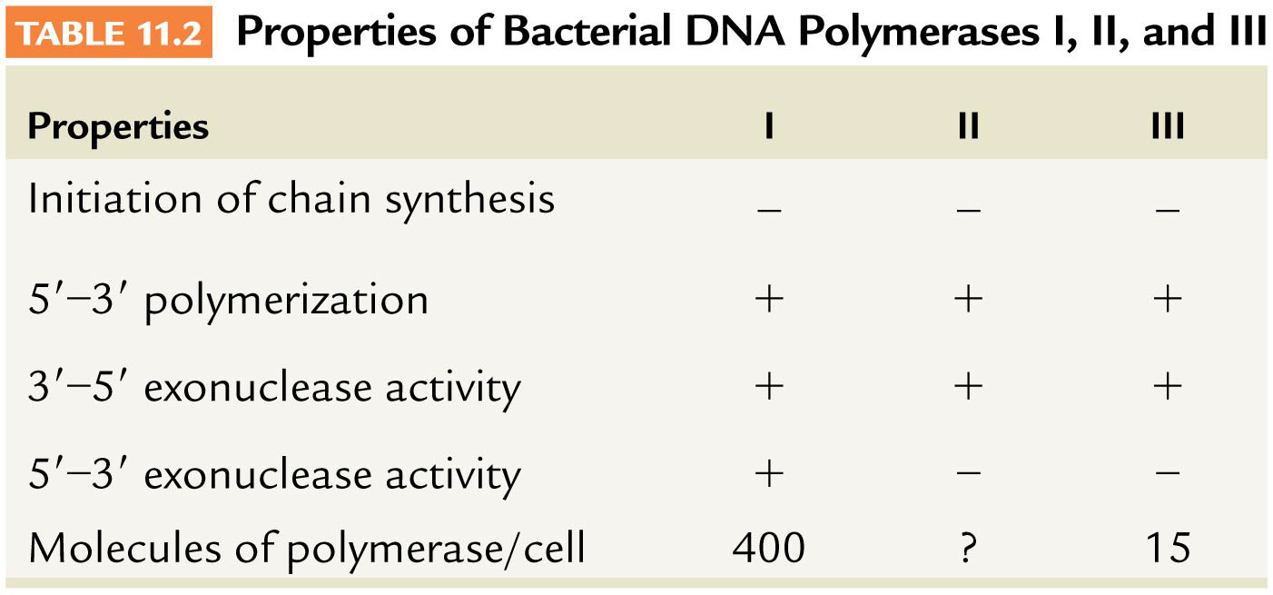
Where were we?
DNA polymerase proofreading—what is it?
DNA polymerase activities—table 11.2
Explain each line of the table

Slide 5
How exactly does an enzyme have more than one activity?
Pol III is actually a multi-protein complex where different individual proteins (subunits) have specialized roles. Figure 11.9
The complete active enzyme is called the holoenzyme

Slide 6
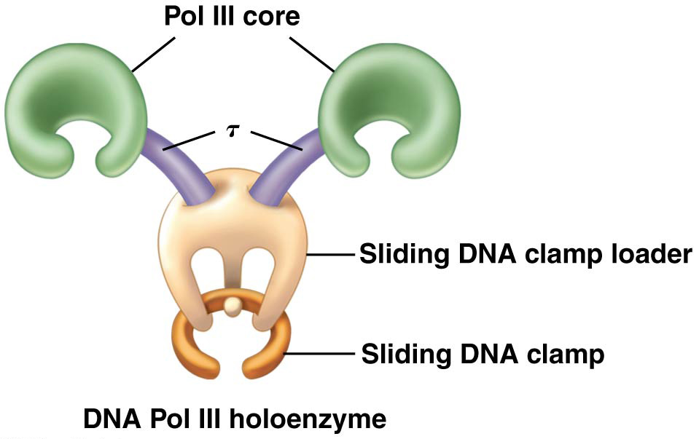
Fig. 11-9

Slide 7
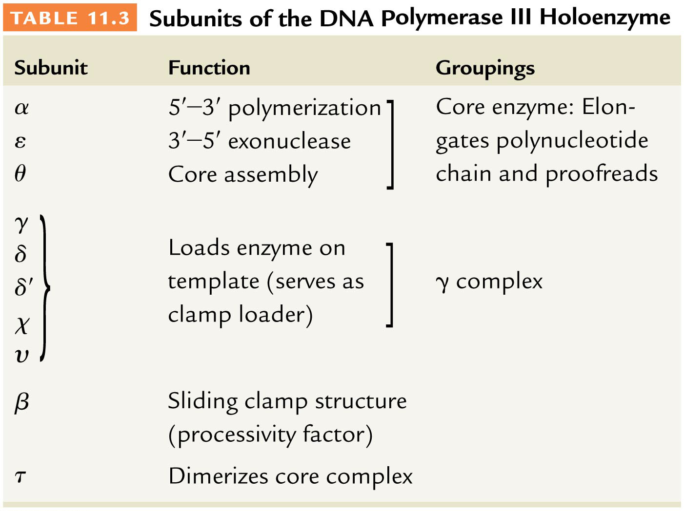
Table 11–3

Slide 8
A model of eukaryotic DNA pol holoenzyme

Slide 9
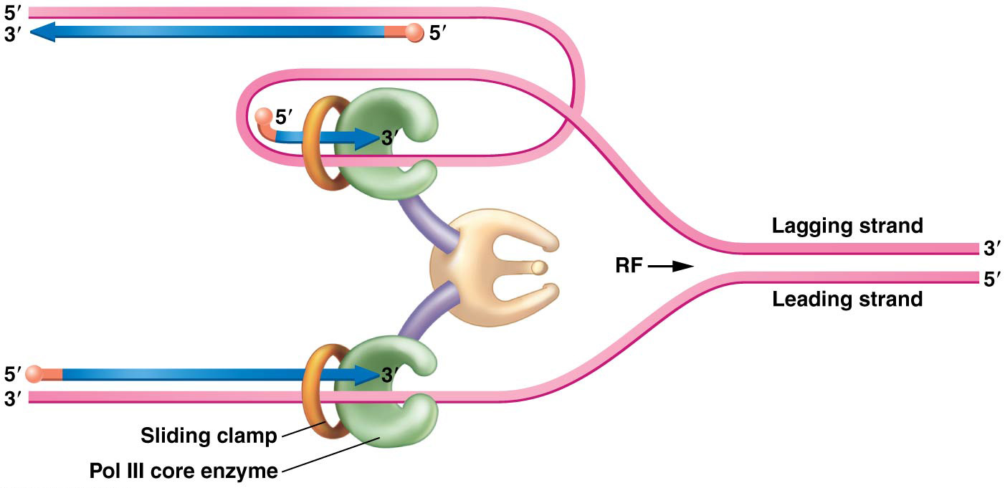

Slide 10
Back to telomeres…
Telomeres also form really interesting DNA structures.
In the process of extending tandem telomere repeats, the repeated Gs form unusual G=G base pairs. These from a temporary continuous double strand hairpin structure.
Figure 11.17

Slide 11
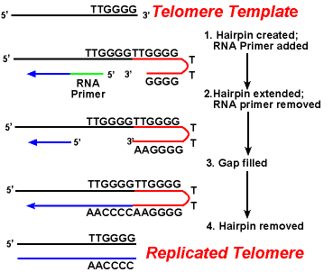

Slide 12
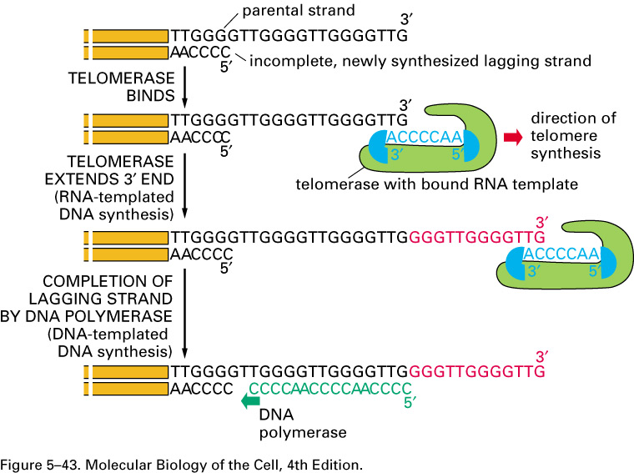

Slide 13
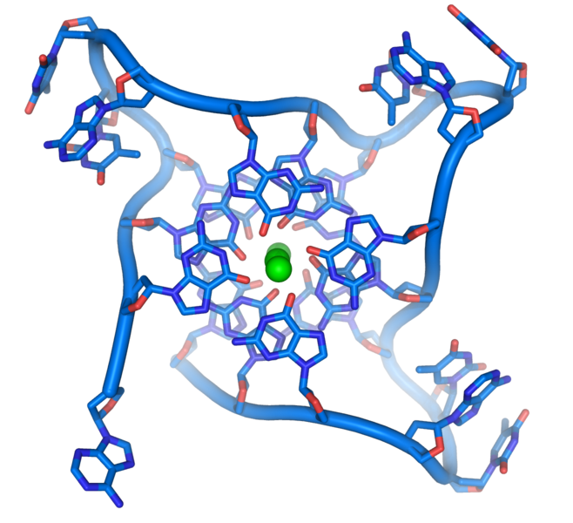
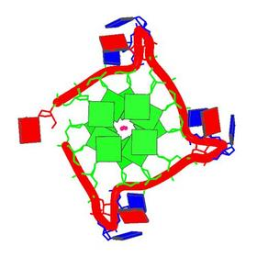
Once telomerase finishes the telomeres assume some additional unique structure including quadruple helix formations.

Slide 14
The repeated Gs associate in the center of this 4-strand structure, sometimes called a knot.
Here is another example of how specific DNA sequence can alter, to a certain extent, the structure formed in the DNA. (Recall Z-DNA?)

Slide 15
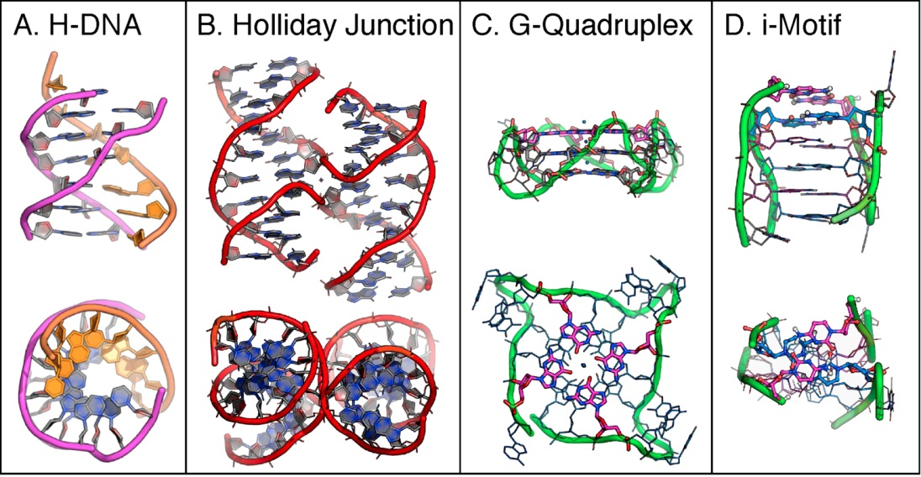

Slide 16
Recall….
A major role of telomeres is also to prevent the interaction and degradation of linear DNA molecules at their ends. Free DNA ends tend to initiate recombination—fusing to other DNA ends and they tend to be digested by Dnases.
Telomeres are important in preventing different chromosomes from fusing and being eaten by enzymes.

Slide 17
In addition to the unusual structure, telomeres also bind specific proteins---telomere-binding proteins—One such group of proteins is called the Shelterin complex,
These likely provide additional protection from fusion and degradation.

Slide 19
Back to DNA replication
More about eukaryotes. What is the model eukaryotic organism?
We’ve already discussed an aspect of replication unique to eukaryotes---telomeres.
We also mentioned early on that eukaryotic chromosomes have multiple ARS sequences.
11.14

Slide 20
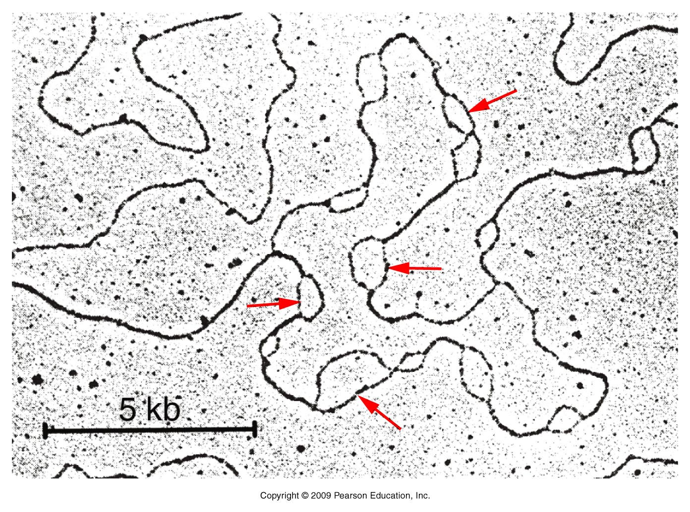
Figure 11.14
Notes:
Figure 11-14 A demonstration of the multiple origins of replication along a eukaryotic chromosome. Each origin is apparent as a replication bubble along the axis of the chromosome. Arrows identify some of these replication bubbles.

Slide 21
Why would eukaryotes utilize more than one initiation site?
Eukaryotes have multiple chromosomes
As a rule, eukaryotes have LOTS more DNA to copy than prokaryotic organisms.

Slide 22
S-phase
In eukaryotes, the DNA is replicated during a specific part of a larger cell cycle that prepares the cell for division.
But not all ARS sequences initiate at once. Yeast have shown us that multiple (20-80) adjacent ARS sequences seem to fire sequentially.

Slide 23
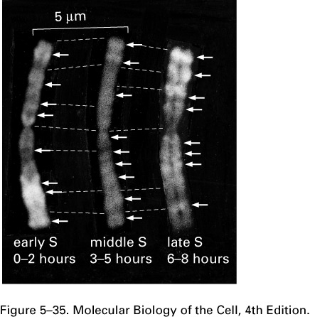
The arrows point to regions of the chromosome that are replicating at different times during S-phase

Slide 24
Surprisingly (or not), eukaryotic DNA polymerases have a slower rate of polymerizing DNA..
This rate is known as processivity.
Eukaryotic DNA pols---make DNA at a rate of ~2000 nucleotides/second
Prokaryotes---about 50,000 nucleotides/second

Slide 25
Hypothesize…
Why can’t eukaryotic polymerases go as fast?
DNA in eukaryotes is not naked and polymerases must maneuver through nucleosomes to synthesize new strands.
We know that there is not an extensive stripping of histones in the process. Figure 11-15

Slide 26
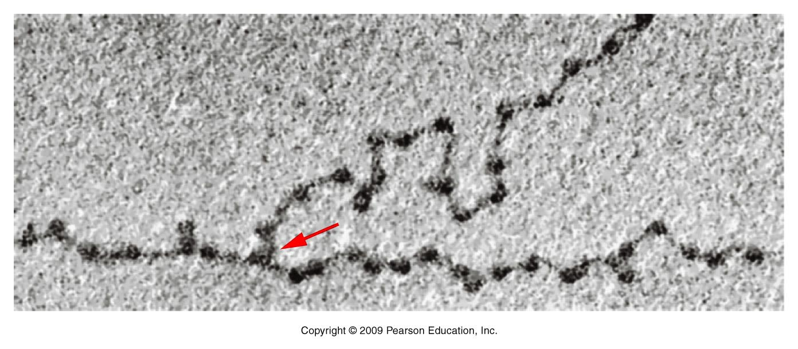
Figure 11.15
Notes:
Figure 11-15 An electron micrograph of a eukaryotic-replicating fork demonstrating the presence of histone-protein-containing nucleosomes on both branches.

Slide 27
Although there is evidence that newly synthesized histones are utilized to form nucleosomes as new DNA is made, there is much debate about how this works.

Slide 28
For example, at least some histones show increased production during S-phase, compared to other phases of the cell cycle.
But there is also evidence that old nucleosomes (or at least components of old nucleosomes) remain associated with the DNA as replication proceeds.

Slide 29
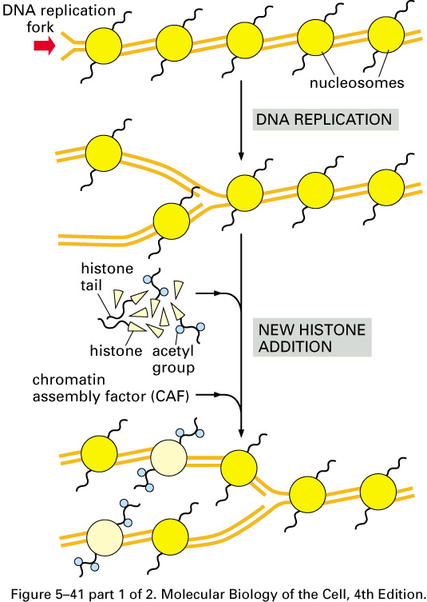

Slide 30
Minireview
Split Decision: What Happens to Nucleosomes during DNA Replication?*
Published, JBC Papers in Press, January 21, 2005, DOI 10.1074/jbc.R400039200
Anthony T. Annunziato‡

Slide 31
Eukaryotic DNA polymerases Read about them
5 different DNA pols work to replicate eukaryotic nuclear DNA, whereas 1 DNA pol repilcates DNA in mitochondria.
Table 11.5. What does 3’-5’ exonuclease activity imply?
HOW do eukaryotes manage to replicate big genomes relatively fast?

Slide 32
DNA repair
DNA polymerases are active at times other than S-phase.
Several types of DNA repair require replacement of short or even extensive regions of DNA. Although a host of enzymes may be used to recognized, remove, and prepare for DNA repair, if the fix requires new DNA it is always synthesized by a DNA polymerase. Gaps in DNA strands are repaired by DNA ligases.

Slide 33
DNA damage/DNA repair
DNA can be damaged in many ways by a variety of agents.
For example, different types of radiation (UV, ionizing) damage DNA in different ways.
UV radiation can cause adjacent Ts in a DNA strand to become crosslinked. The DNA lesion is called a Thymidine dimer.

Slide 34
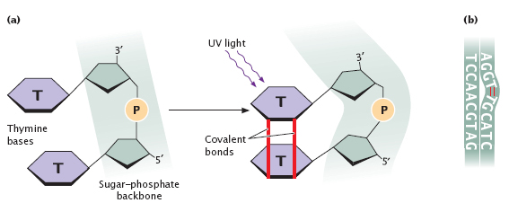
All DNA damage, including T-T dimers cause potential changes in DNA sequence or DNA breaks when that DNA region is replicated again.

Slide 35
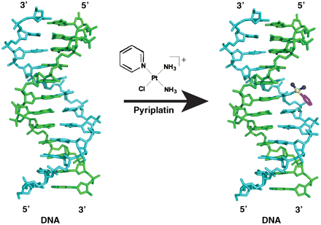
Chemicals can be added to DNA nucleotides creating adducts. Platinum and derivatives can bind DNA causing strands to become covalently linked.

Slide 36
Base-specific alterations:
Oxidation of bases
Alkylation of bases (such as methylation)
Loss of bases by hydrolysis “depurination” deamination, de-pyrimidination
Attachment of a bulky chemical group
Base mis-match

Slide 37
These types of DNA alterations occur in one strand of the DNA double helix and rely on the “good strand” to act as template for DNA polymerases to copy.
(see chapter 15—15.8)

Slide 38
Types of single strand DNA repair
Base excision repair
Nucleotide excision repair
Mismatch base repair

Slide 39
DNA damage can involve both strands of DNA as well.
Double strand breaks are repaired in one of 3 ways. All involve some type of joining mechanism somewhat similar to that which occurs during DNA recombination (for example during meiosis).
Non-homologous end joining
Microhomology mediated end joining
Homology mediated end joining

Slide 40
We will return to these repair mechanisms later when we talk about DNA mutation.
But…for now…How do you think the details of DNA repair mechanisms were figured out?
What is Xeroderma Pigmentosum?

